Slide 1
Meesho Orders Dashboard
Interactive Business Dashboard Presentation

Slide 2
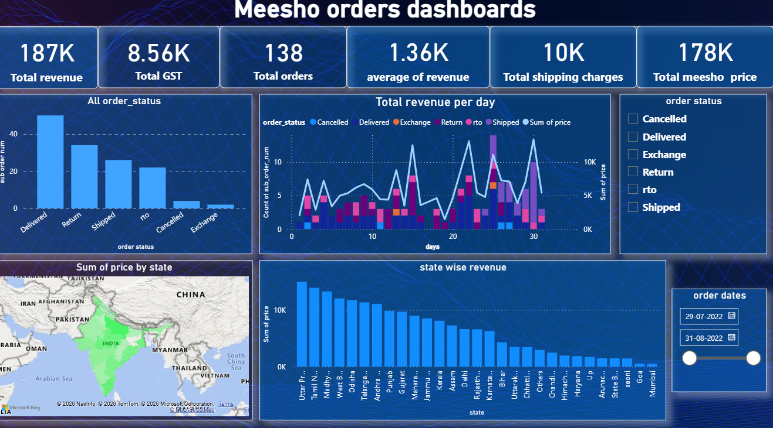
Dashboard Overview

Slide 3
Key Insights
• Total Revenue reached 187K
• Total Orders completed: 138
• Delivered orders dominate overall performance
• Revenue varies significantly across states
• State-wise revenue analysis highlights top-performing regions
• Daily revenue trends reveal operational fluctuations

Slide 4
Dashboard Features
• KPI cards for quick executive overview
• Interactive slicers and filters
• Revenue trend analysis
• Order status tracking
• Geographic state-wise revenue visualization
• Dynamic date filtering

Slide 5
Business Recommendations
• Improve shipping efficiency
• Reduce cancellations and returns
• Expand focus on high-performing states
• Monitor daily revenue patterns
• Optimize operational costs for profitability

